Slide 1
Recipe Preparation agent
CAPSTONE PROJECT
Presented By : Khushi S Kittur
College Name : Dayananda Sagar Academy of Technology and Management
Department : Information Science and Engineering

Slide 2
OUTLINE
Problem Statement
Technology used
Wow factor
End users
Result
Conclusion
Future scope
IBM Certifications
Git-hub Link

Slide 3
Problem Statement
Home cooks often face the challenge of deciding what to prepare using the limited ingredients they have available. Searching for suitable recipes online can be time-consuming and often fails to account for missing ingredients, dietary restrictions, or personal preferences. This leads to food waste, inefficiencies in meal planning, and added stress during cooking.
Proposed Solution: A Recipe Preparation Agent that leverages Retrieval-Augmented Generation (RAG) and AI to suggest customized recipes based on the ingredients users have on hand. The agent retrieves relevant recipes, adapts them to ingredient limitations, and provides step-by-step instructions. It also suggests ingredient substitutions, cooking tips, and dietary modifications to accommodate preferences or restrictions—making everyday cooking smarter, simpler, and more sustainable.

Slide 4
Technology used
IBM cloud lite services
Natural Language Processing (NLP)
Retrieval Augmented Generation (RAG)
IBM Granite model

Slide 5
IBM cloud services used
IBM Cloud Watsonx AI Studio
IBM Cloud Watsonx AI runtime
IBM Cloud Agent Lab
IBM Granite foundation model

Slide 6
Wow factors
This agent will help reduce food waste, save time, and make everyday cooking more efficient by turning available pantry items into practical meal solutions. It supports smarter meal planning, adapts to ingredient limitations, and enhances the home cooking experience.
Unique features:
Tailored recipe suggestions based on available groceries
Step-by-step cooking instructions adapted to current ingredients
Ingredient substitution recommendations
Cooking tips for better results with limited ingredients
Dietary adjustments based on user preferences or restrictions
Retrieval-Augmented Generation (RAG)-based system for accurate and relevant recipe retrieval

Slide 7
End users
Home Cooks
Busy Professionals
Students
Families
People with Dietary Restrictions
Environmentally Conscious Consumers
Beginner Cooks

Slide 8
Results
Welcome Page

Slide 9
Results

Slide 10
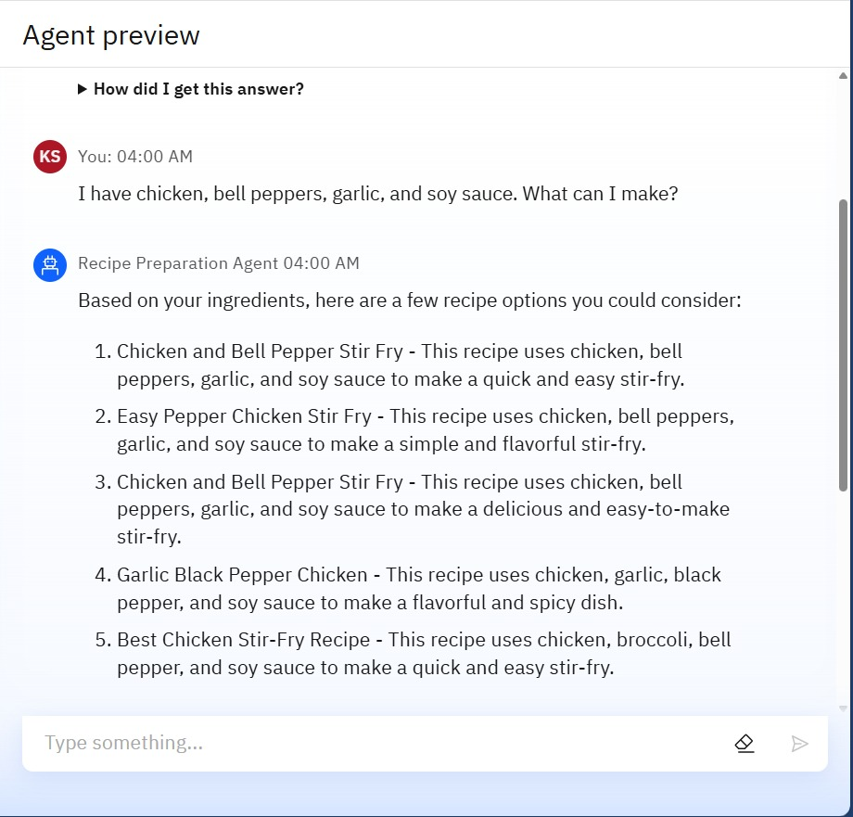
Results

Slide 11
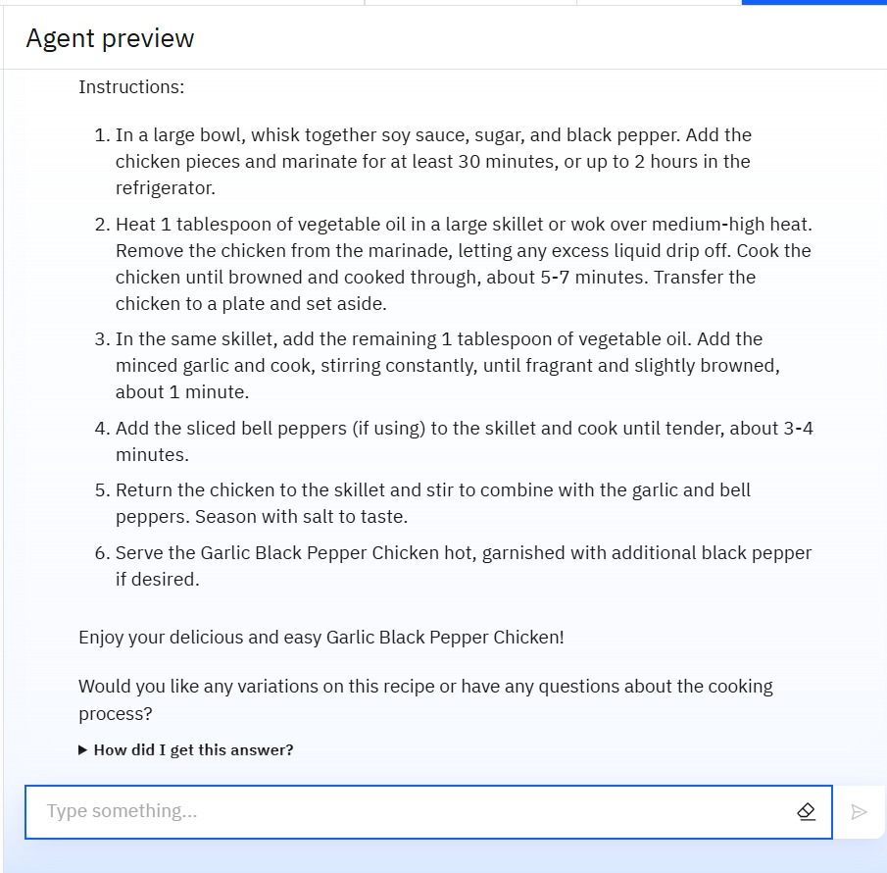
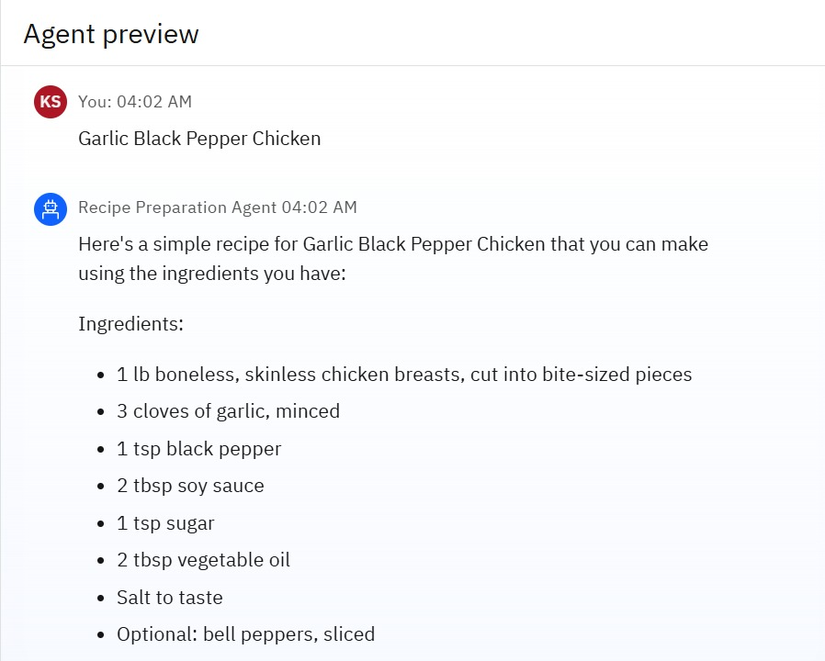
Results

Slide 12
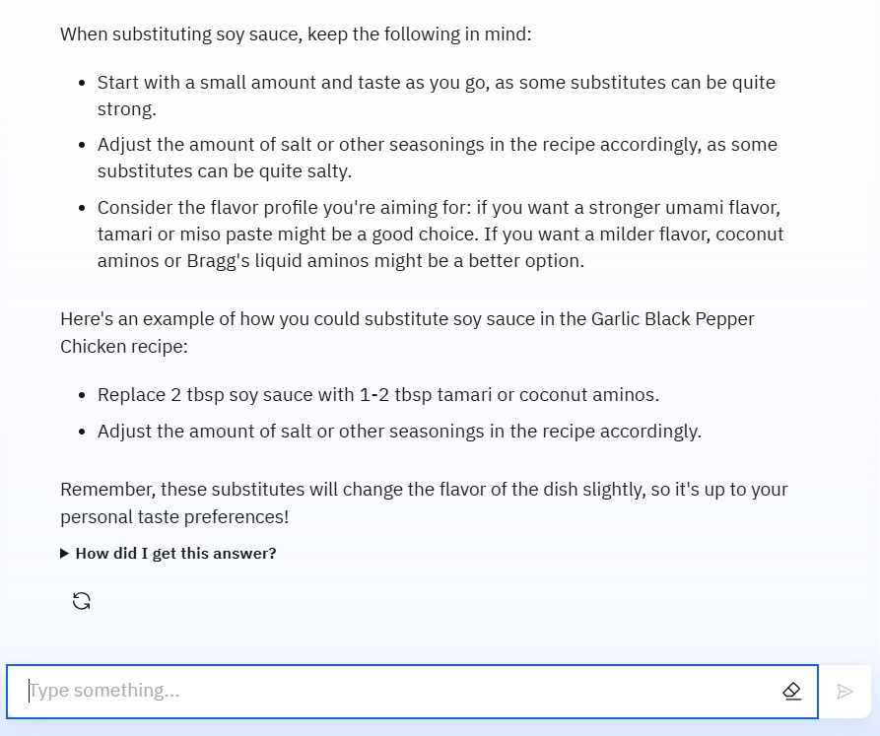
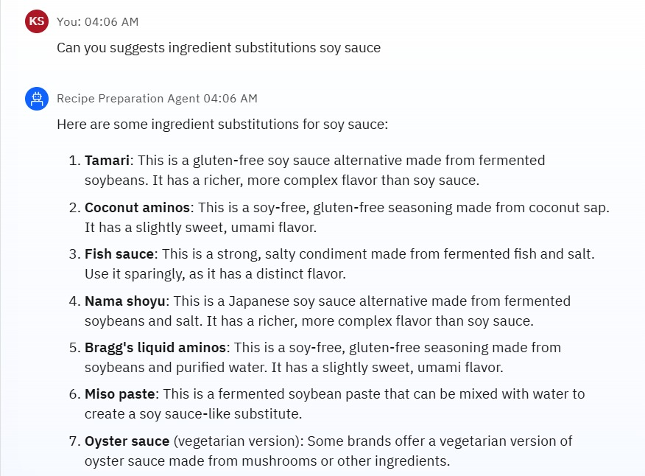
Results

Slide 13
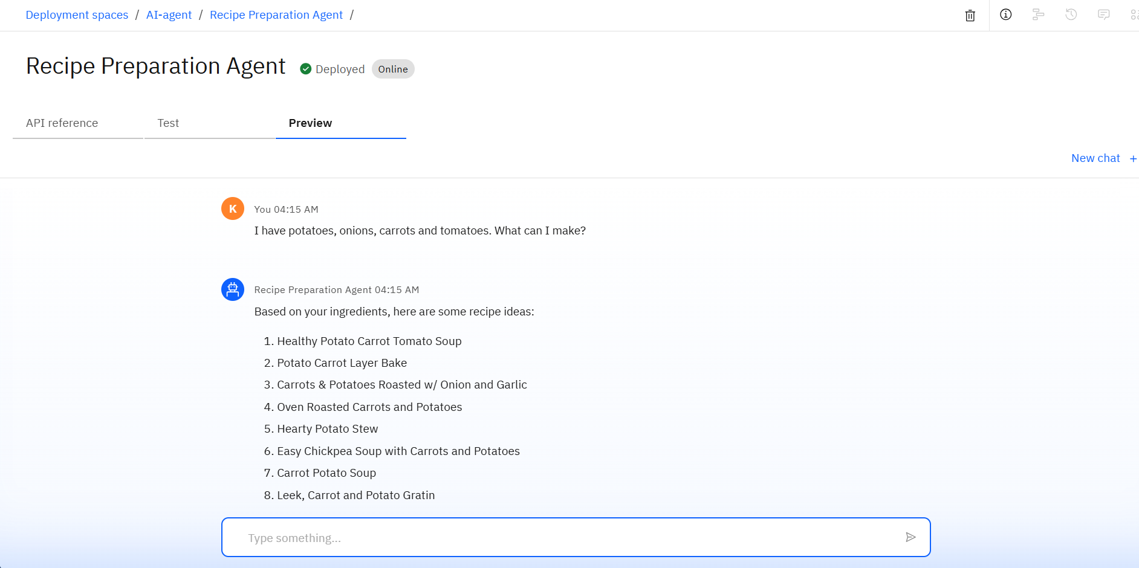
Results
Deployed AI Agent

Slide 14
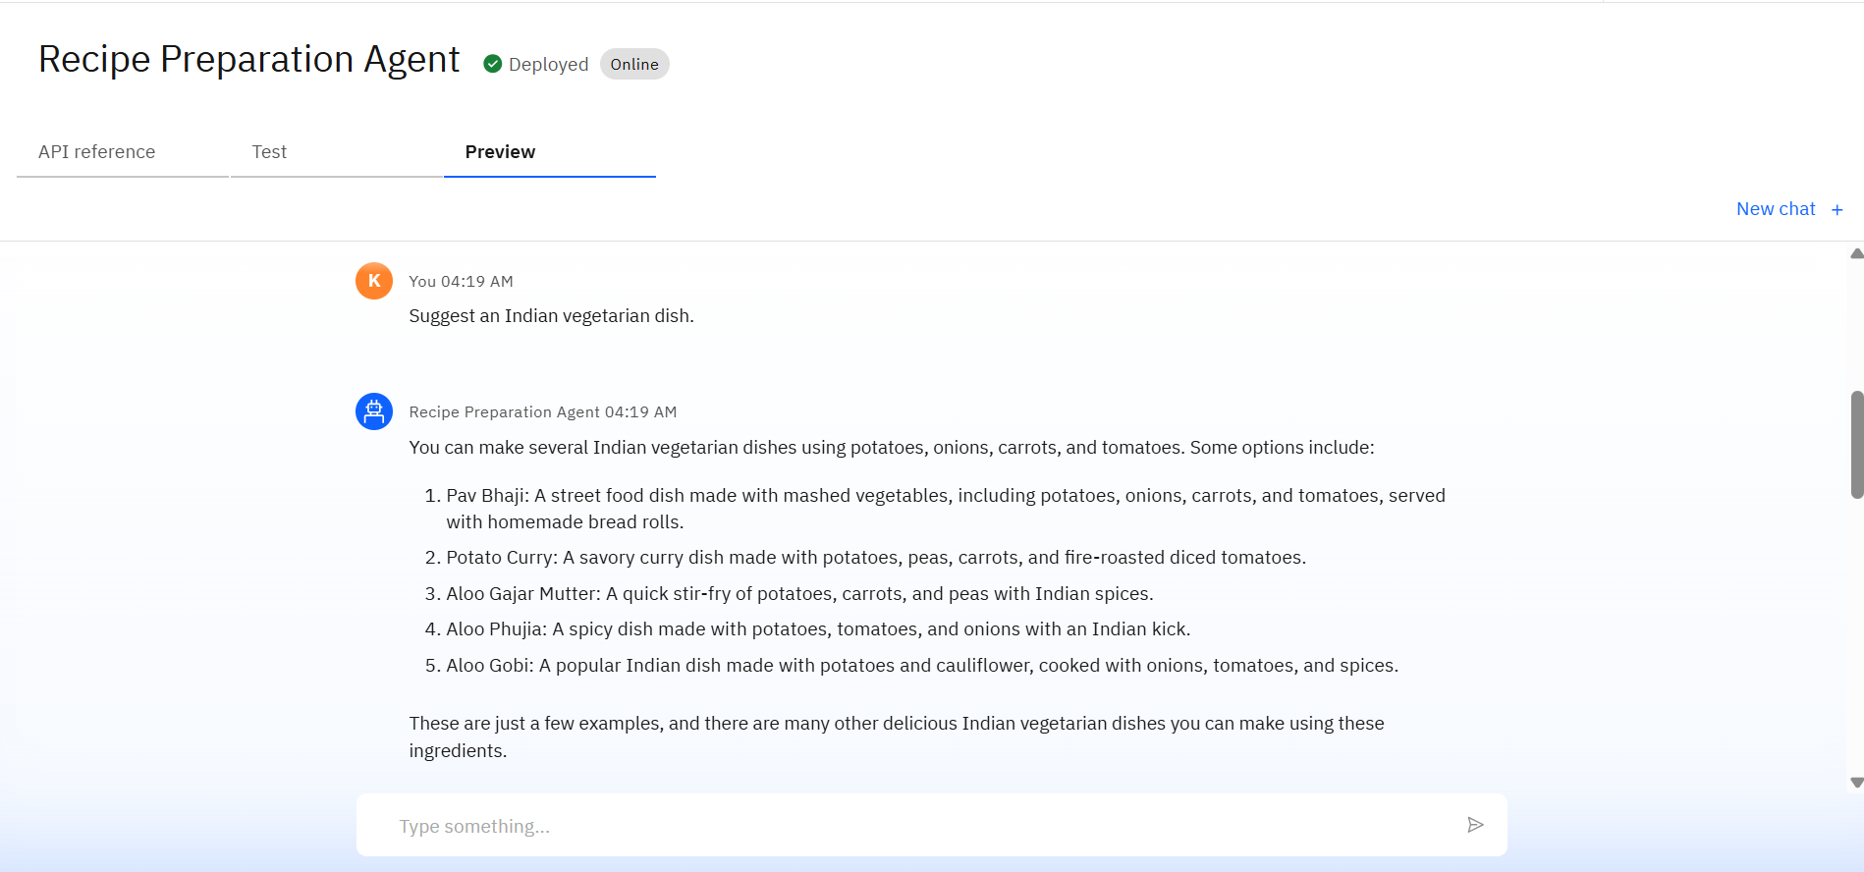
Results

Slide 15
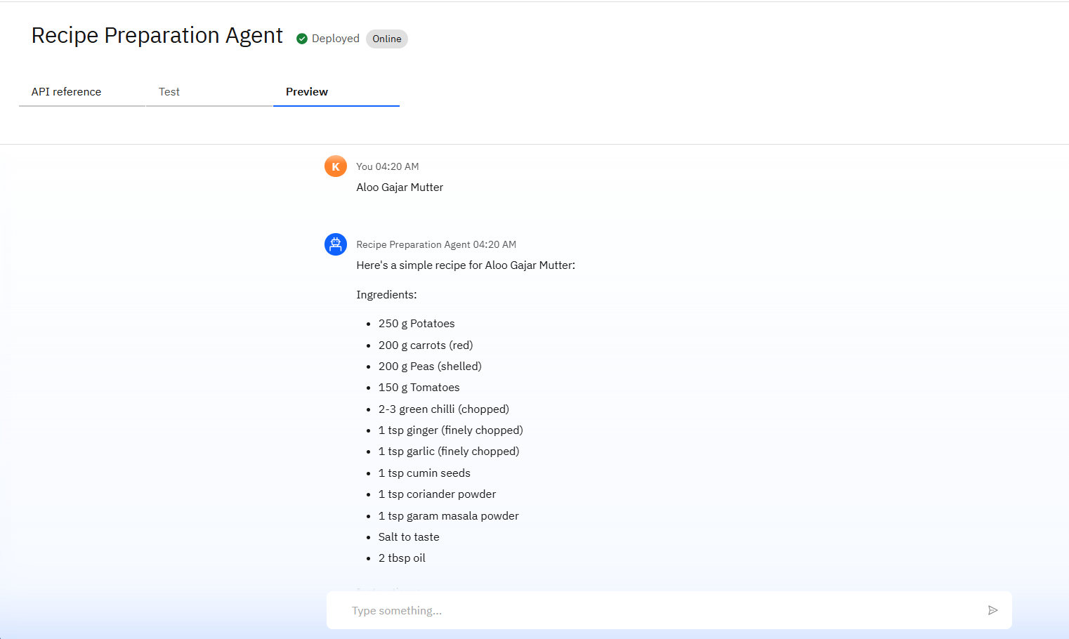
Results

Slide 16
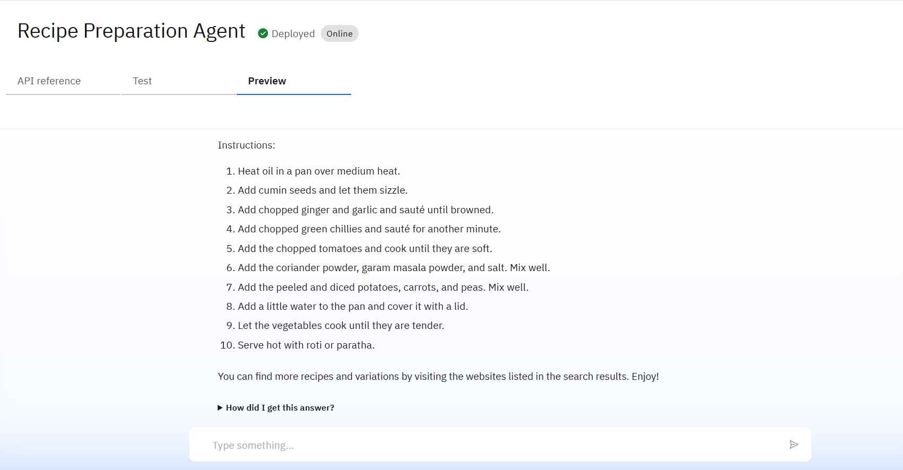
Results

Slide 17
Conclusion
The agent can generate personalized recipes, suggest ingredient substitutions, and provide step-by-step cooking instructions based on available groceries.
It saves time by automating meal planning and reduces food waste through smart ingredient usage.
Recipe Preparation Agents enhance efficiency, sustainability, and creativity in everyday home cooking.

Slide 18
Future scope
Multilingual Recipe Support
Voice-Activated Cooking Assistant
Real-Time Ingredient Recognition via Image Input
Integration with Smart Kitchen Devices
Meal Planning and Grocery List Generation
Nutritional Analysis and Health Tracking
Personalized Recipe Recommendations Based on User History

Slide 19
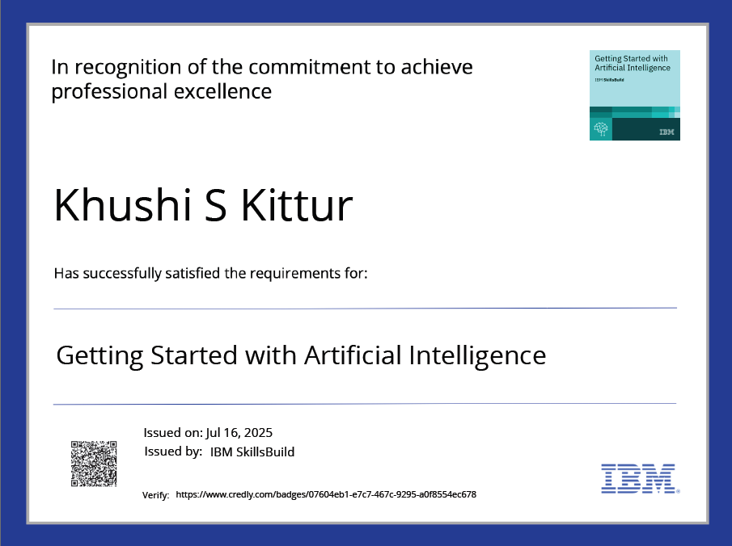
IBM Certifications
Getting Started with Artificial Intelligence

Slide 20
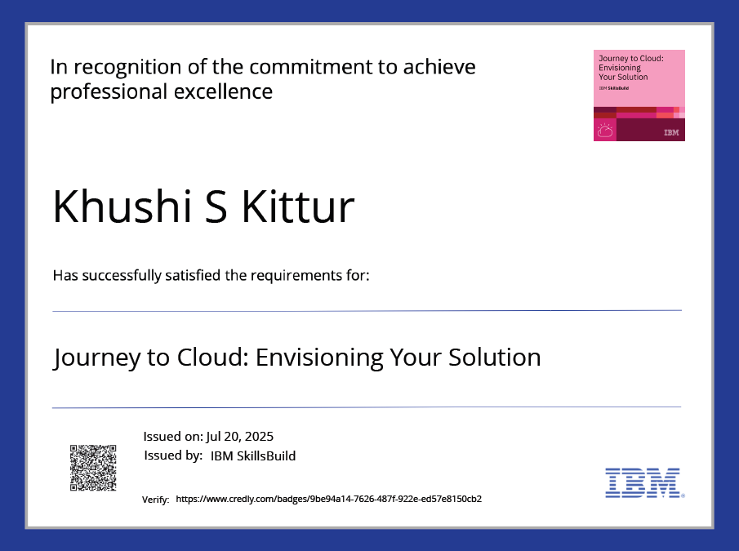
IBM Certifications
Journey to Cloud

Slide 21
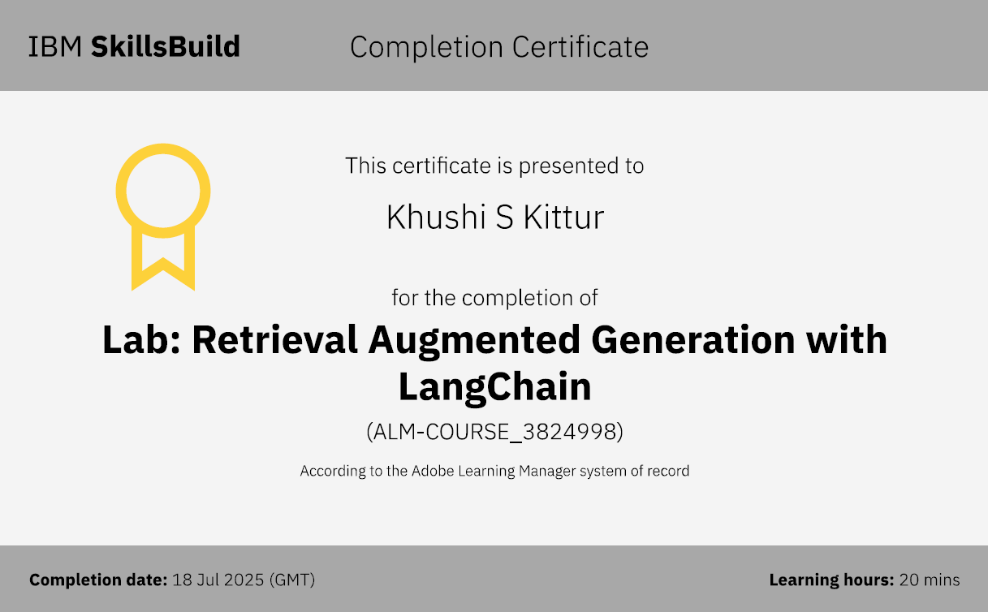
IBM Certifications
Lab: Retrieval Augmented Generation with LangChain

Slide 22
GitHub Link
Khush435/IBM-Cloud-Recipe-Preparation-agent

Slide 23
THANK YOU

